Slide 1
The Michelin Guide Ethnic Bias and What Constitutes “Good Food”
Joyce Chou
LaunchCode Women+ Data Analysis
March 8, 2023

Slide 2
What is the Michelin Guide?
Ratings system for restaurants
Awards:
3 stars: “Exceptional cuisine, worth a special journey”
2 stars: “Excellent cooking, worth a detour”
1 star: “High quality cooking, worth a stop”
Bib gourmand: “Good quality, good value cooking”
Awarded for “For the quality of their food based on five criteria:
Quality of the ingredients used,
Mastery of flavor and cooking techniques,
The personality of the chef in his cuisine,
Value for money and consistency between visits.”

Slide 3
Dataset and Business Issue
Michelin Guide Restaurants from Kaggle
Version 37, updated December 15, 2022
Scraped and updated quarterly from Michelin Guide website.
In recent years, there have been criticisms that the gastronomic community is unfairly dominated by Eurocentric standards, and that significant bias exists against non-European cuisines when considering what constitutes “good food”.
Is the Michelin Guide, ethnically biased?

Slide 4
Exploratory Data Analysis
Fields:
Name
Address
Location (city and country, separated by delimiter)
Latitude
Longitude
Cuisine (cuisine type, up to two separated by delimiter)
Price (various currencies, 0-4 symbols to indicate priciness)
Phone Number
Website URL
Facilities and Services (other amenities, multiple separated by delimiters)
Award
URL (page on Michelin Guide website)
Notes:
Challenges:
Location, Cuisine, Facilities and Services have delimiters and require splitting.

Slide 5
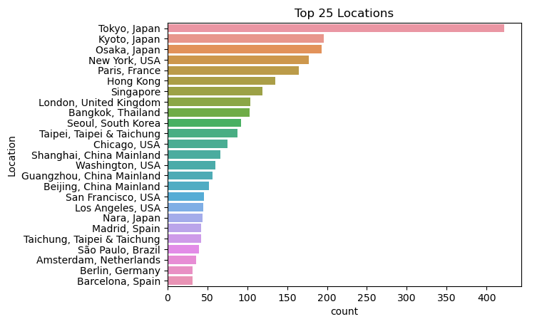
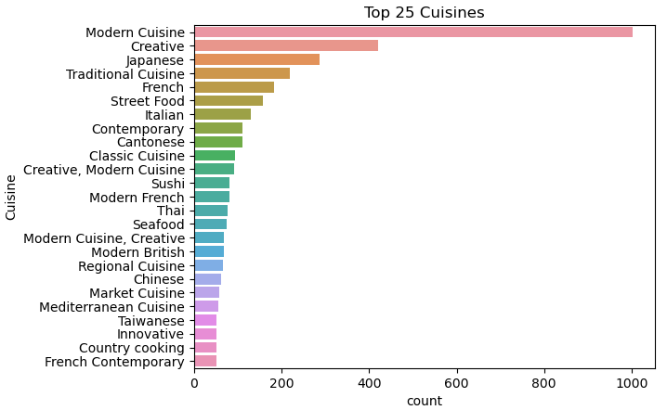
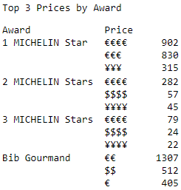
Exploratory Data Analysis
Notes:
Of note:
Initial analysis reveal a mix of East Asian, European, and US restaurants/cuisines receiving awards.

Slide 6
Data Cleaning
Histograms and box plots for missing data.
Renaming null values to ‘None’.
Dropping city from Location.
Dropping characters from Price to determine Currency.

Slide 7
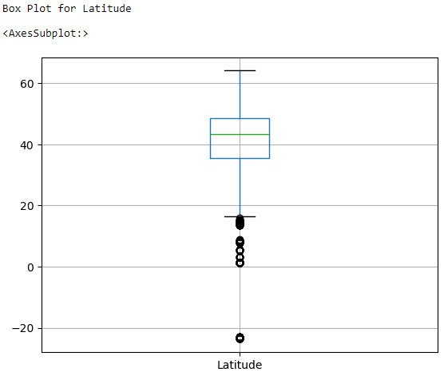
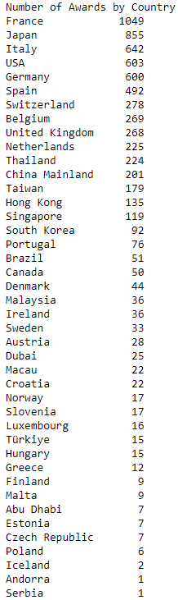
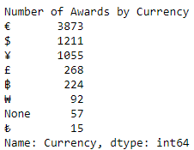
Data Cleaning

Slide 8
Data Manipulation and Interpretation
Manipulation
Creating an additional field for Priciness.
Splitting the Cuisine field at delimiters and creating an additional dataframe.
Interpretation
Tableau Story

Slide 9
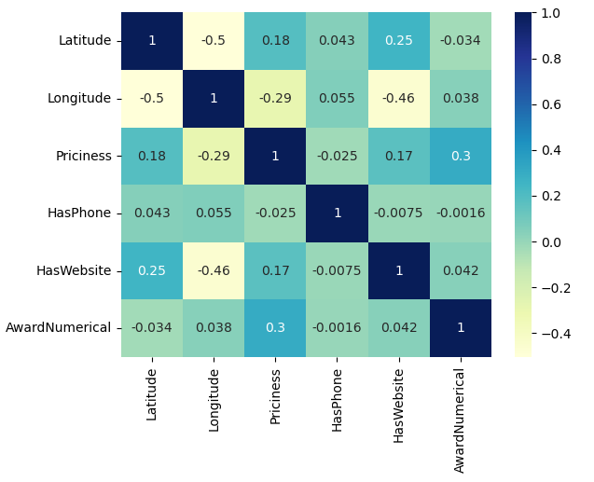
Data Modeling
Correlation between priciness and award ranking. Is priciness a confounding factor?
A weak correlation:

Slide 10
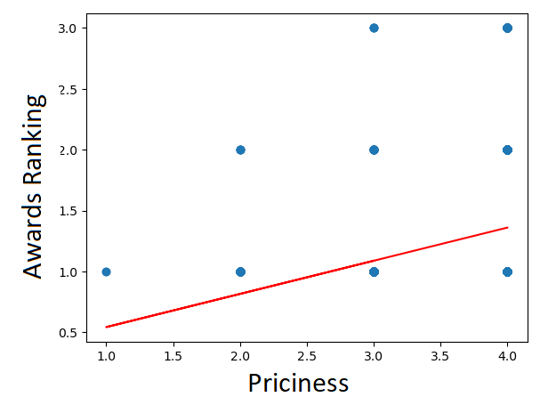
Data Modeling

Slide 11
Conclusions
Location and ethnic biases in Michelin Guide rankings do exist.
Priciness of the restaurant is likely not a confounding factor affecting the awarding of rankings.

